Slide 1

Cloud Foundry Architecture
Deep Dive & Pro Tips

Slide 2
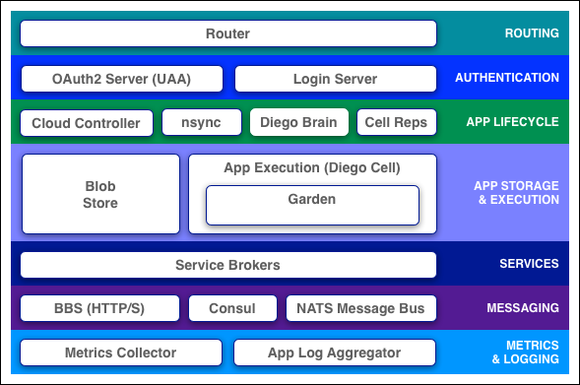
Components
Cloud Foundry components include a self-service application execution engine, an automation engine for application deployment and lifecycle management, and a scriptable command line interface (CLI), as well as integration with development tools to ease deployment processes. Cloud Foundry has an open architecture that includes a buildpack mechanism for adding frameworks, an application services interface, and a cloud provider interface.

Slide 3

Message Bus
Non-Persistent messaging
Pub/Sub
Queues (app events)
Directed messages (INBOX)
Notes:
Cloud Foundry uses NATS, a lightweight publish-subscribe and distributed queueing messaging system, for internal communication between components.

Slide 4


Router
Load Balancing
This could be mixed with HAProxy
Maintain Routing Table
Dynamic Routing Table Inside NATS
Access Logs
Just as it is done in Apache or nginx
Notes:
The Router routes traffic coming into Cloud Foundry to the appropriate component: usually, Cloud Controller or a running application on a DEA node. The router is implemented in Go. Implementing a custom router in Go gives the router full control over every connection, which makes it easier to support WebSockets and other types of traffic. A single process contains all routing logic, removing unnecessary latency. It maintains a dynamic routing table for each load-balanced app instance with IP addresses and ports for access via the internet.

Slide 5

UAA
Token Server
ID Server
User management
OAuth Scopes
Group management
User Access Auditing
Notes:
The UAA is the identity management service for Cloud Foundry. Its primary role is as an OAuth2 provider, issuing tokens for client applications to use when they act on behalf of Cloud Foundry users. It can also authenticate users with their Cloud Foundry credentials, and can act as an SSO service using those credentials (or others). It has endpoints for managing user accounts and for registering OAuth2 clients, as well as various other management functions.

Slide 6

Cloud Controller
App Expected State
Permissions / Authz
Orgs / Spaces / Users
Services Management
App Placement
App Desired State Convergence
Auditing / Journaling
Billing Events
Blob Storage
Notes:
The Cloud Controller is responsible for managing the lifecycle of applications. When a developer pushes an application to Cloud Foundry, he is targeting the Cloud Controller. The Cloud Controller then stores the raw application bits, creates a record to track the application metadata, and directs a DEA node to stage and run the application. The Cloud Controller also maintains records of orgs, spaces, services, service instances, user roles, and more.

Slide 7

nsync - BBS - Cell Rep
Maintains the actual state of apps
Compares to the expected state
Notes:
The Health Manager monitors application uptime/health by looking for mismatched application states (expected/actual). The Cloud Controller provides the expected state and the DEAs provide the current state. If the Health Manager sees an incorrect current state, it notifies the Cloud Controller.

Slide 8

Diego Brain - Garden - Buildpacks
Diego:
Manage containers (Garden)
Manage app lifecycle
App log and file streaming
Apps and Diego Cells heartbeats
Buildpacks:
Staging
Detect, Compile, Release
Configure droplet
Runtime (Ruby/Java/Node/Python)
Container (Tomcat/Websphere)
Application (.WAR, .rb, .py)
Notes:
A DEA (Droplet Execution Agent) uses Warden to create a secure and fully isolated container – a DEA can run one or multiple apps each one of this inside its own warden container. DEAs are responsible for an app’s lifecycle: Buildpacks create app droplets which execute on a warden container inside the DEA. As today release (v183) the standard buildpacks are:
Go
Java
Ruby
Python
PHP
nodejs

Slide 9
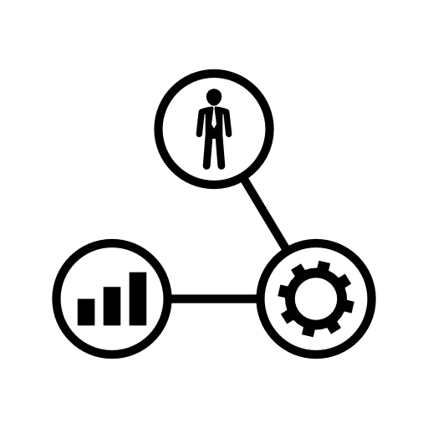
Service Broker
Makes create / delete / bind / unbind calls to service nodes
Requests inventory of existing instances and bindings from cloud controller for caching, orphan management etc.
Notes:
Applications typically depend on services such as databases or third-party SaaS providers. When a developer provisions and binds a service to an application, the service broker for that service is responsible for providing the service instance. So a Service Broker provides an interface for both native and external 3rd party services.

Slide 10
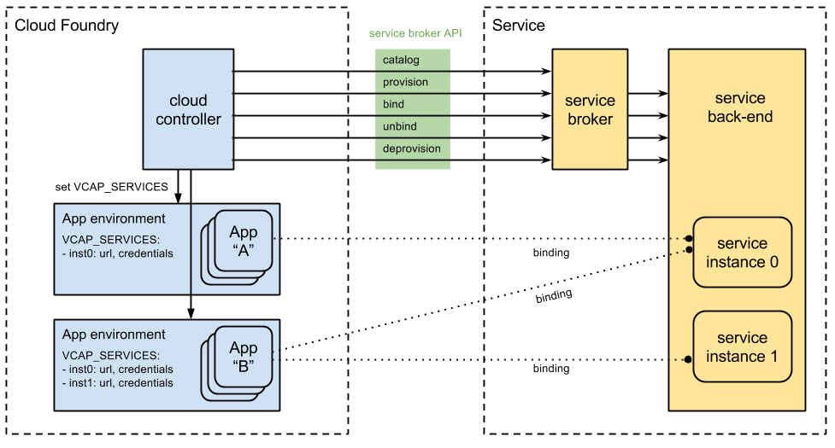
Service Broker

Slide 11
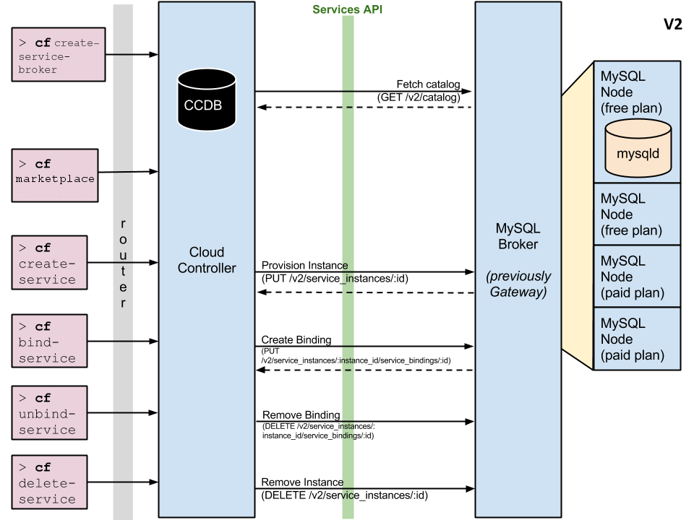
.
IDEM
.

Slide 12
> cf push = deploy
Blob Store (S3, etc.)
CCDB
(MySQL)
Droplet
DEA Nodes
Stager
Metadata
Pkg
Pkg
Build packs
W
R
o
u
t
e
r
Stage A1
Cloud Controller
CLI
Droplet
Executor
Pkg
Deploy A1
A1
A2
Metadata
A1
A3
Users
A1.yourdomain.com
A2
A3
Frontend
Backend

Slide 13
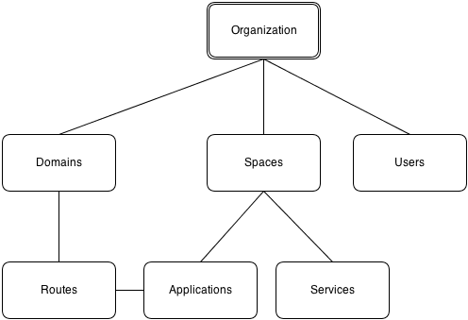
Orgs, Spaces, Quotas & Users
Organizations: An organization is the top-most meta object within the Cloud Foundry infrastructure. Spaces: An organization can contain multiple spaces. The defaults for a standard Cloud Foundry install are development, test, and production. Domains: A domain is a domain-name like acme.com or foo.net. Routes: A route, based on a domain with an optional host as a prefix, may be associated with one or more applications.

Slide 14
PaaS Best Practices
Brought To You By 12factor.net

Slide 15
Some Factors
Dependencies (package your app)
Local Disk Storage
Avoid writing to the Local File System (S3, Riak, MongoDB)
It is short-lived / ephemeral
Instances of the same app do not share a local file system
Stateless - HTTP Sessions Not Persisted or Replicated

Slide 16
Some Factors
Configuration Variables
Hard coded Vs ENVIRONMENT (e.g: listening ports)
Only HTTP (80), HTTPS(443) and WSS(4443) ports
Backing Services
Runtimes and Frameworks?
Disposability
http://docs.cloudfoundry.org/devguide/deploy-apps/prepare-to-deploy.html

Slide 17
No downtime deployments
Blue-green deployment release technique

Slide 18
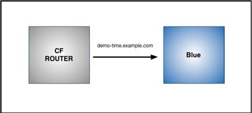
Blue-Green Deployment
One production domain and two apps
Blue → prod
Green → next release
$ cf push Blue -n demo-time

Slide 19
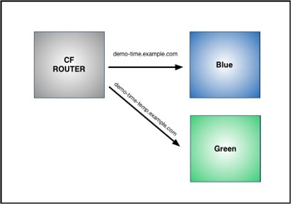
Blue-Green Deployment
Update App and Push
$ cf push Green -n demo-time-temp

Slide 20
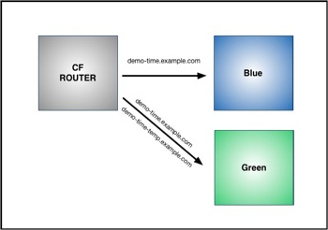
Blue-Green Deployment
Map Original Route to Green
$ cf map-route Green example.com -n demo-time
Binding demo-time.example.com to Green... OK

Slide 21
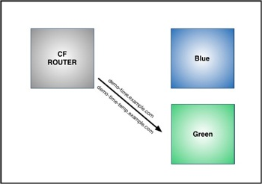
Blue-Green Deployment
Unmap Route to Blue
cf unmap-route Blue example.com -n demo-time-temp
Unbinding demo-time.example.com from blue... OK

Slide 22
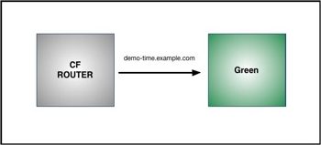
Blue-Green Deployment
Remove Temporary Route to Green
$ cf unmap-route Green example.com -n demo-time-temp

Slide 23
Questions?
?

